Slide 1
Fit & Fun
AI-Powered Workout Companion

Slide 2
Table of Contents
Key Features
Workout Planner
Create Workout Plan
Browse Plans
Archive Plans
Progress Tracker
Diet Planner
Conclusion

Slide 3
Key Features
Designed and developed AI Workout Planner
Workout plans are tailored to the user physical fitness levels and their goals.
High level UI is used for all components to make things clear and crispy.
User Progress Tracker uses “Dynamic User Interface” where based on user plan preference the UI changes itself.
Diet Plans are made with few important parameters and still needs Improvements to get perfect Diet Plan.
Users can seamlessly use different components at once without having trouble.

Slide 4
Workout Planner

Slide 5
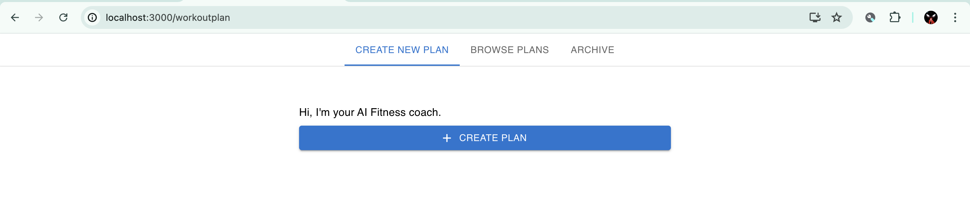
Workout Planner Page mainly consist of Three Tabs
Create New Plan
Browse Plans
Archive

Slide 6
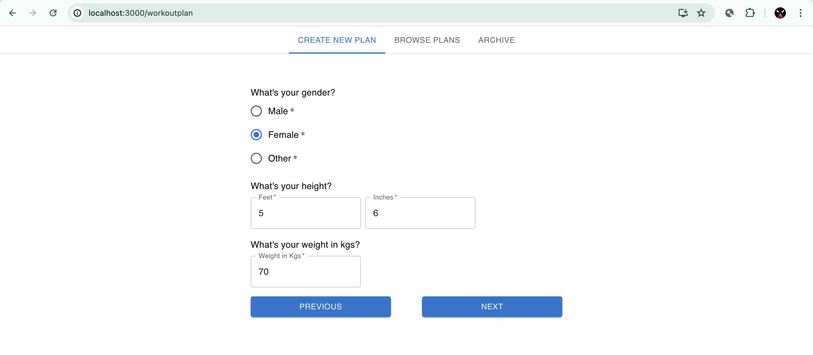
Create New Plan

Slide 7
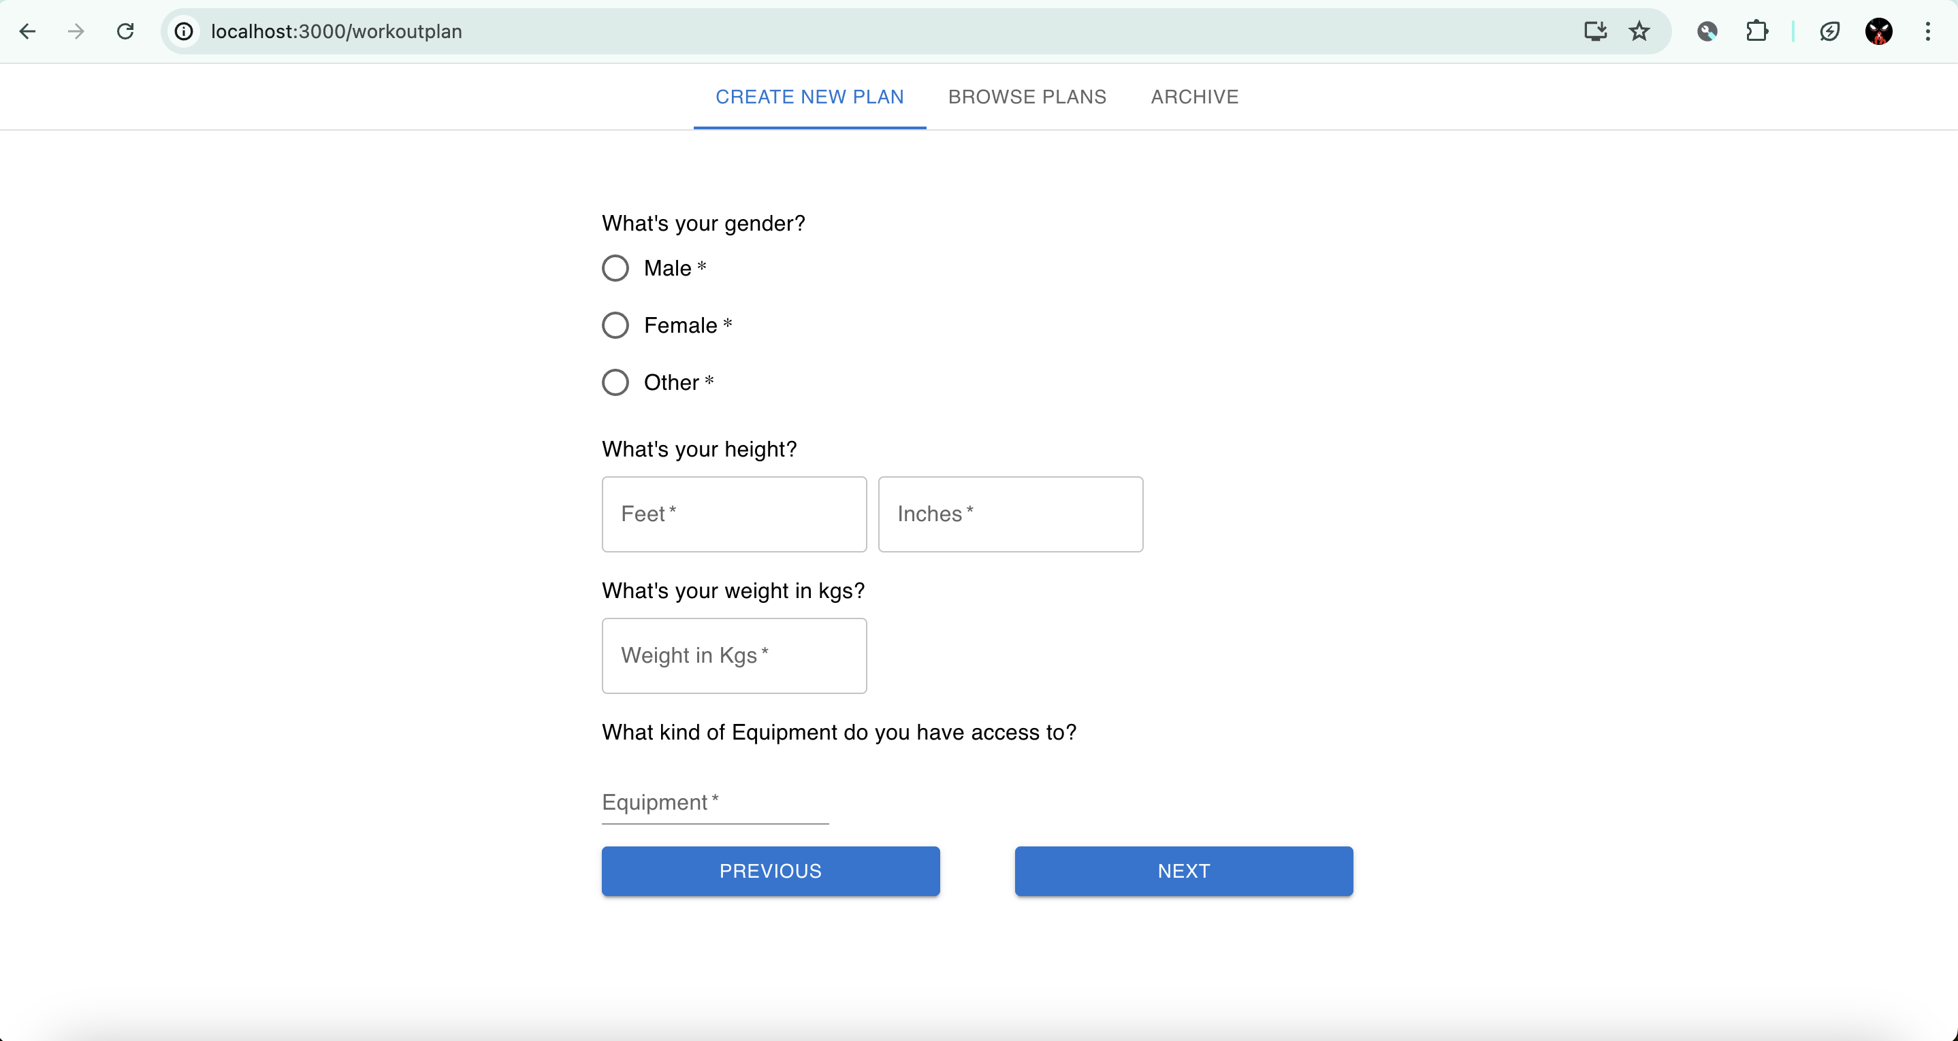

Slide 8
This Tab helps user to create their own workout plan
React State Managements is used to collect different kinds of data as input from the User
These Data includes Gender, Height, Weight, Fitness Goals ( Bulk, Cut, Healthy, Increase Energy ), Muscle Group to focus on ( Abs, Chest, Upper Body, Lower Body, Legs, Full Body )
By the end when user clicks on submit the response of the user are added to request body by the React State.
This request body along with other user data like username, email, isAuth are sent to the Server for generating plan.

Slide 9
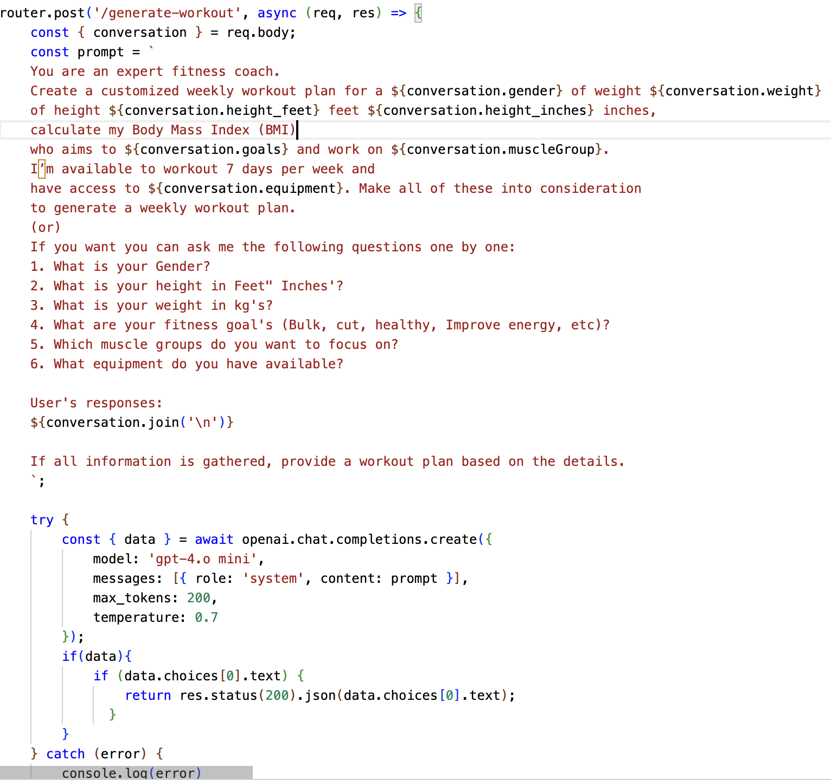
Generating plan at backend
With the help of openAI API, we are posting a request to the ChatGPT’s “gpt-4.o mini” Model.
We then store the user response in a variable called conversation.
From then we use a professional prompt and generate workout plan.
This plan is again sent back to the client.

Slide 10
Making a plan from response
As the server sends the response back to the client, we then format the data to build a clean UI.
The formatted data is used to build our workout plan using a clean and simple table along with other stylings.
The workout plan for a week is displayed for the user along with their BMI status.
Now user can choose to save workout or generate another plan if needed.
Saved plans will be displayed under Browser Plans Tab.

Slide 11
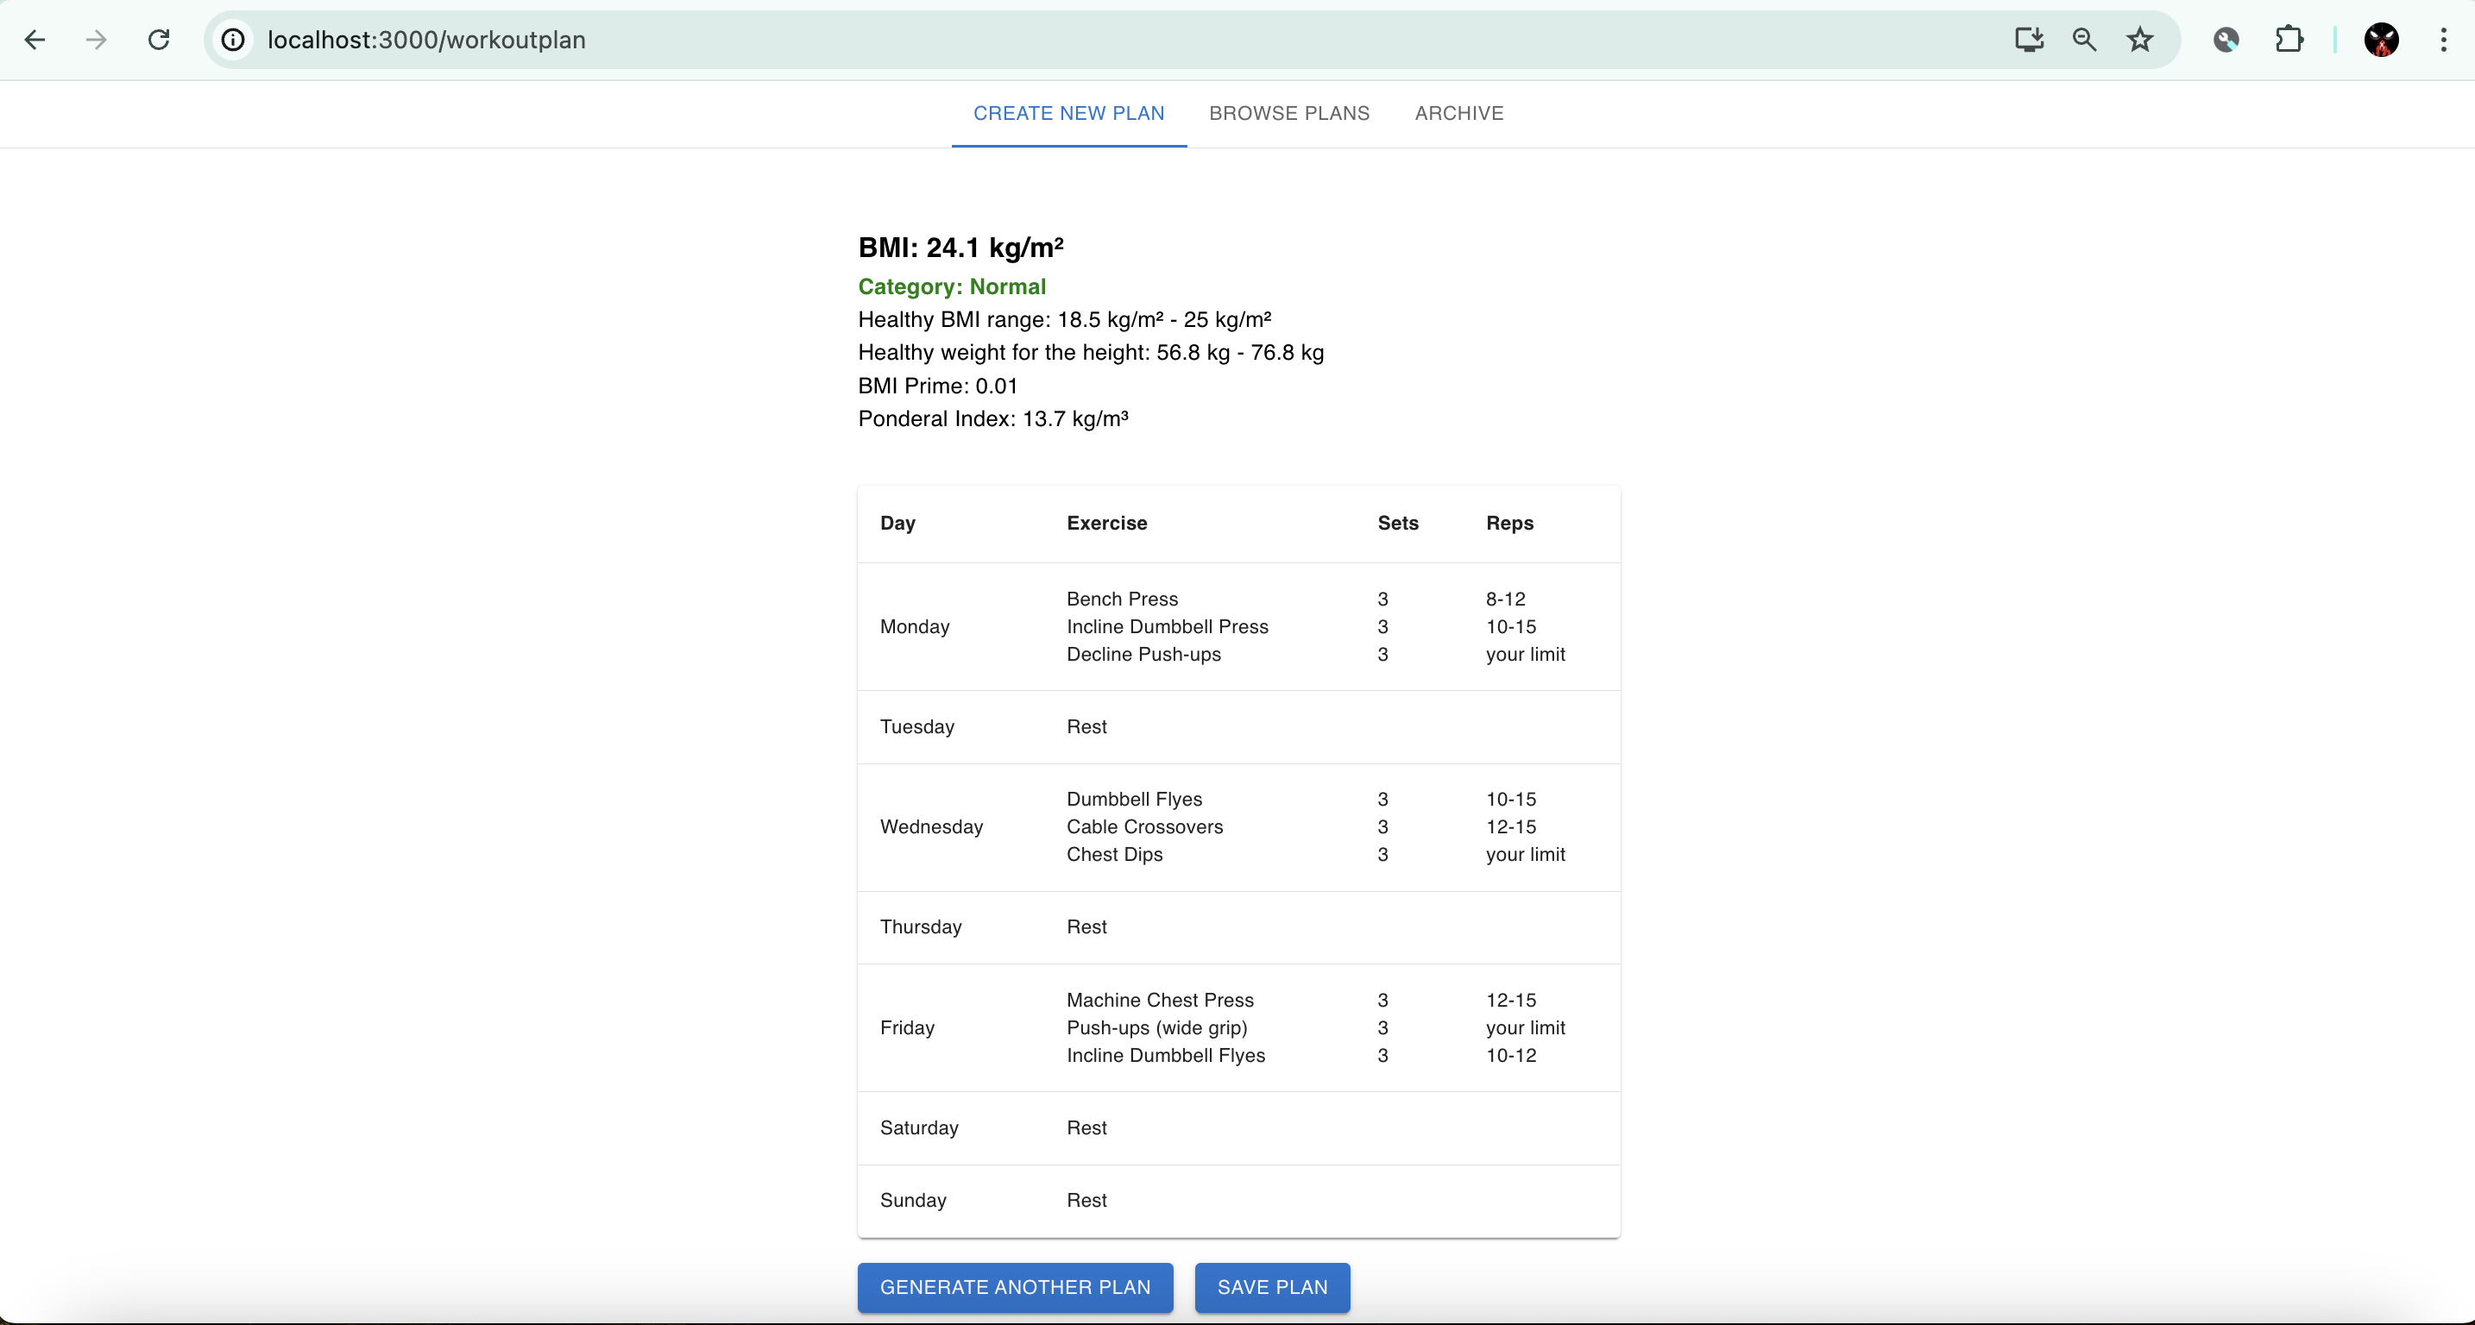

Slide 12
Browse Plans
Saved Plans will be stored in the database under User ID and these are retrieved for the user.
Users can now do the following:
View a collection of saved workout plans.
Search and filter plans by muscle group or workout type.
Select a primary plan to focus on, with easy toggling options.
The primary plan will be shown in Progress Tracker.

Slide 13

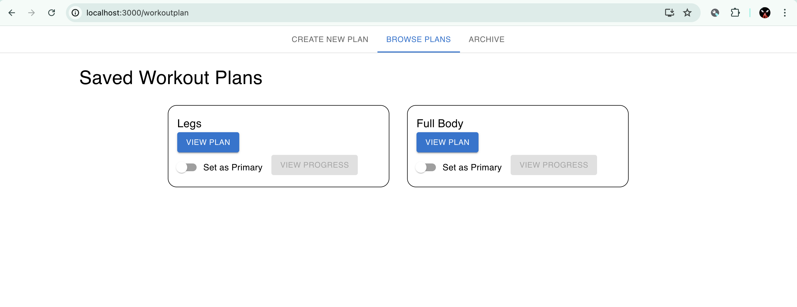

Slide 14
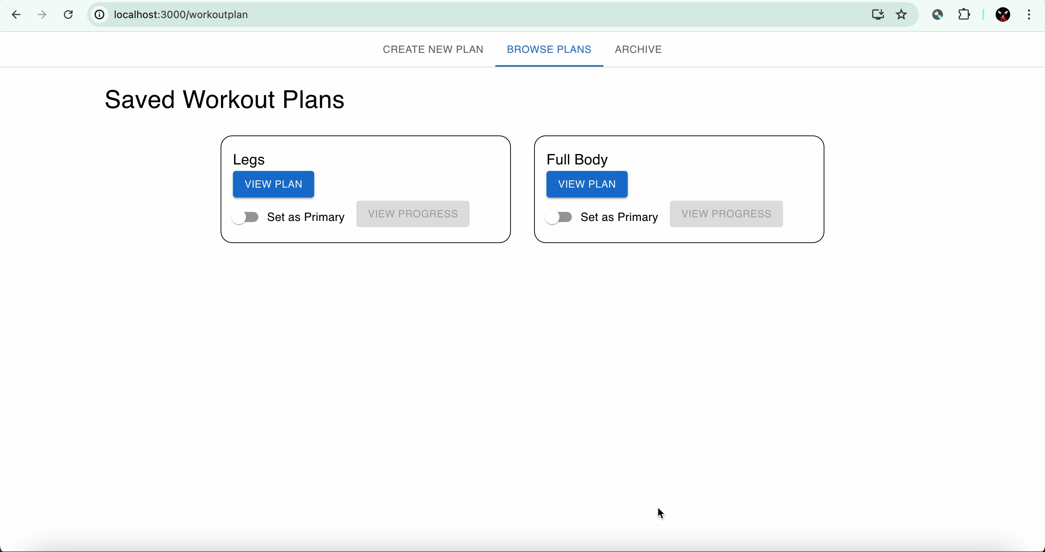

Slide 15
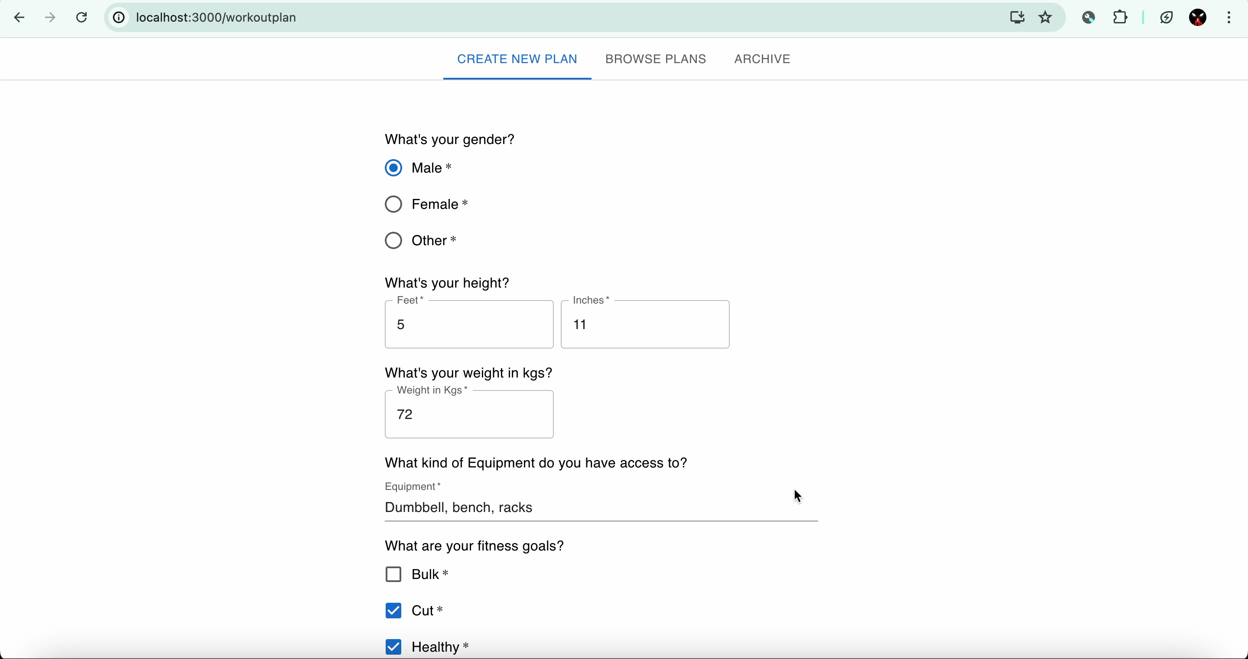
Complete Walkthrough

Slide 16
Archive Plans
Store old or completed workout plans.
Access archived plans anytime to review past routines.
Option to reactivate archived plans if needed.

Slide 17
Progress Tracker

Slide 18
Progress Tracker
Weekly Progress Overview:
Visual representation of weekly workout progress.
Track completed exercises and monitor consistency.
Update progress with a simple checkbox system for each exercise.
Progress Visualisation:
Pie charts showing distribution of exercises by muscle group.
Progress bars indicating weekly completion rates.
Detailed tables listing daily exercises with sets and reps.

Slide 19
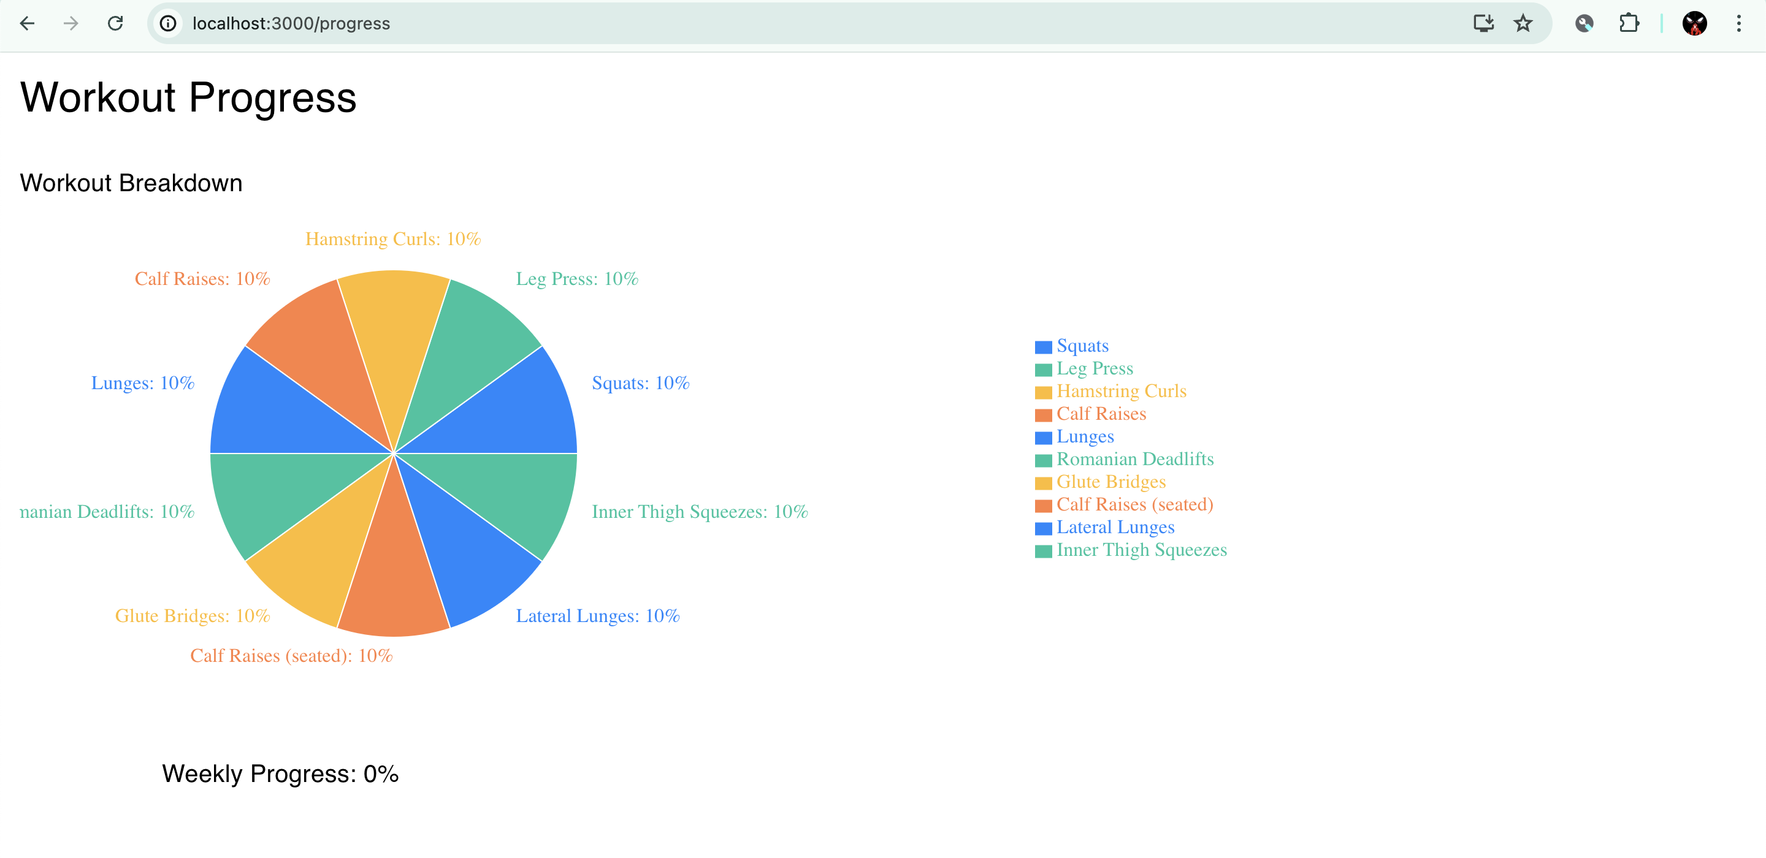

Slide 20
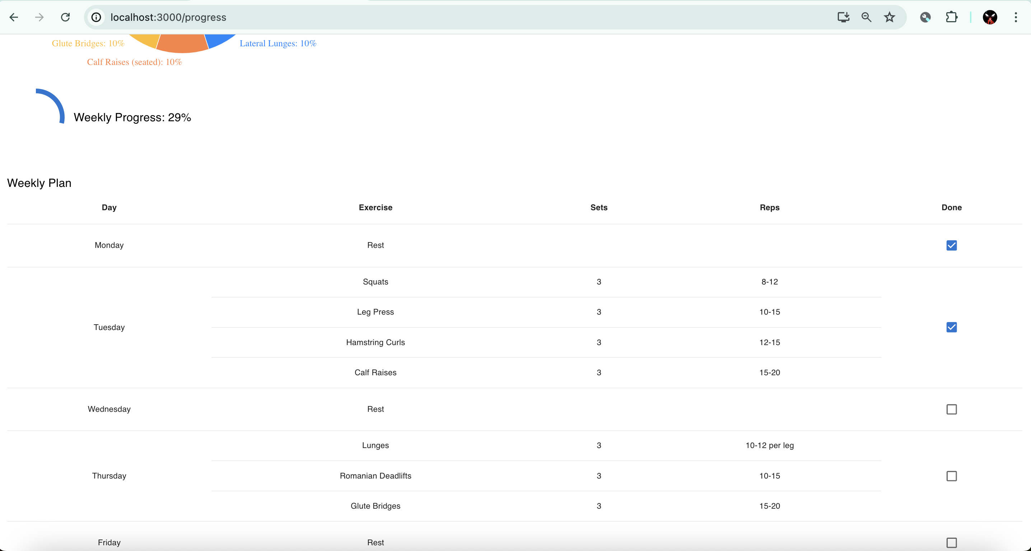

Slide 21
Diet Planner

Slide 22
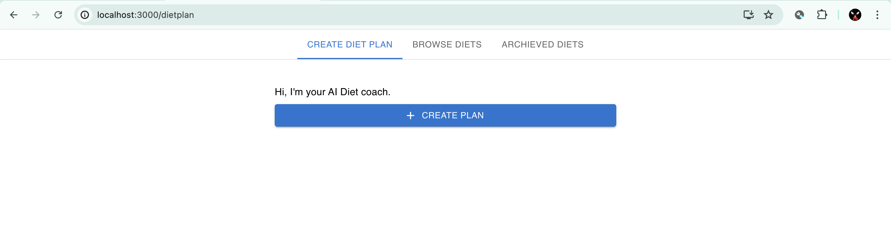

Slide 23
Create Diet Plan
Customise daily meal plans according to dietary goals.
Include macros and calorie information for each meal.
Save and edit plans easily.

Slide 24
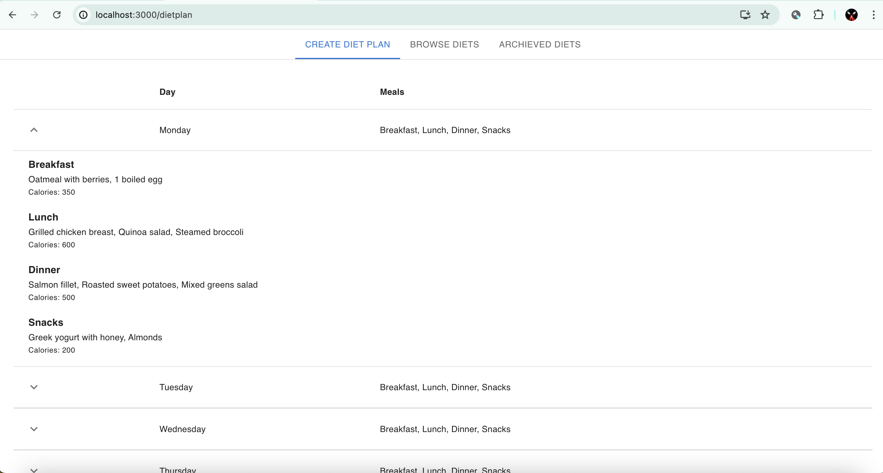

Slide 25
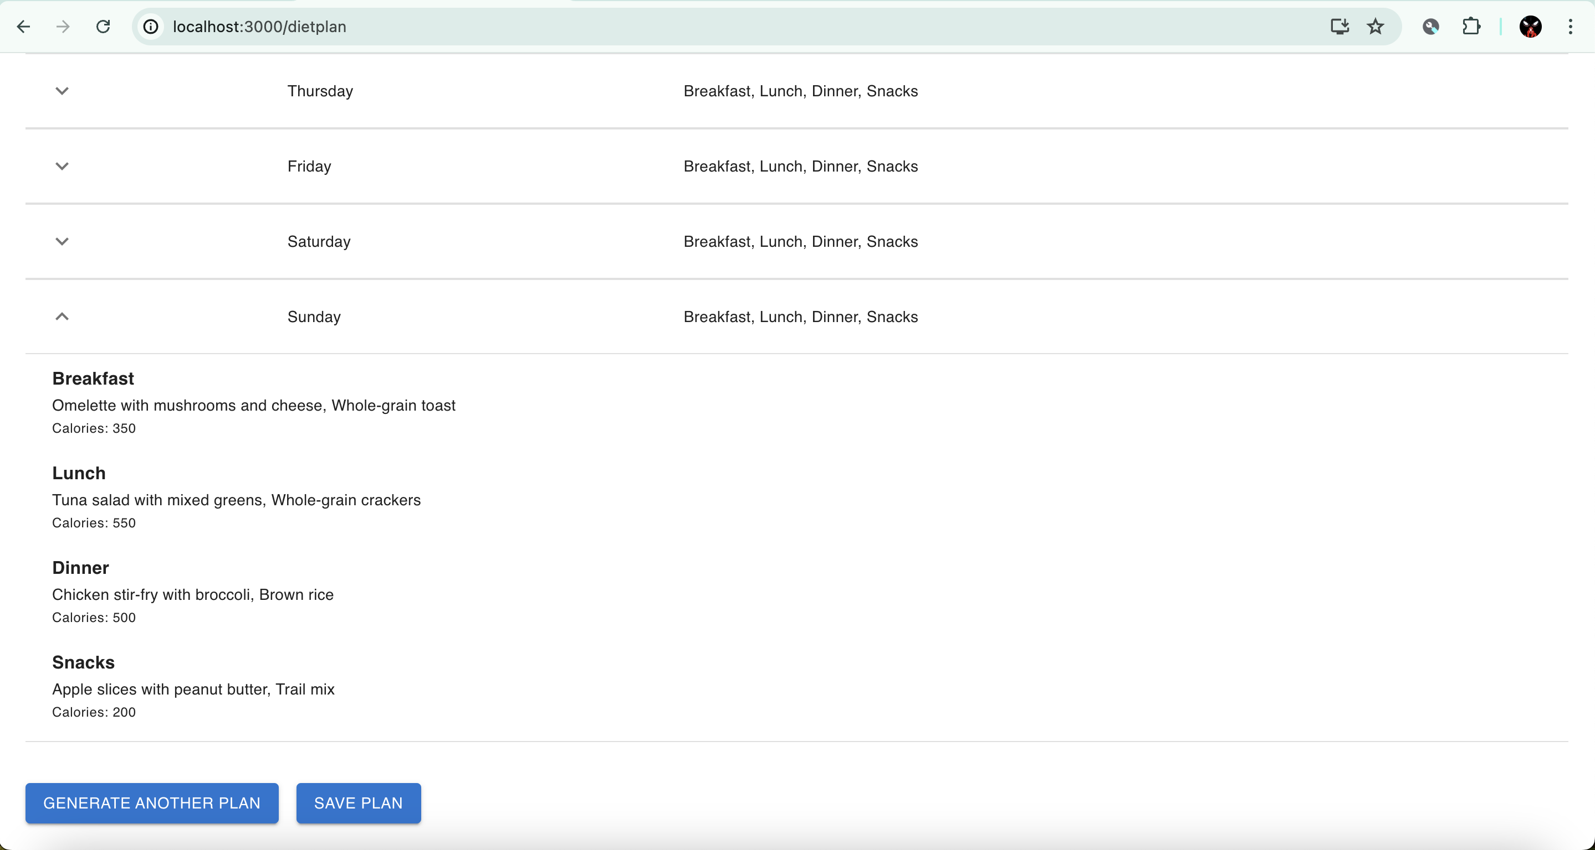

Slide 26
Browse Plans
View a collection of saved diet plans.
Search and filter plans by dietary preference or goal.
Select and follow a diet plan for better health tracking.

Slide 27
Archive Plans
Store old or completed diet plans.
Access archived plans to review past diets.
Reactivate archived plans if needed.

Slide 28
Future Work
Planned Enhancements
Workout progress can be enhanced and send notifications to users through email.
Diet plans are now generated with minimal data can be enhanced with Dietary Restrictions, Food Preferences, Food Allergies, Exercise Routine, Medical Conditions, Medication, Meal frequency and snack preferences

Slide 29
Conclusion
Comprehensive tool for managing workouts and diet.
User-friendly interface for creating, browsing, and archiving plans.
Advanced progress tracking to ensure consistency and improvement.
Ideal for fitness enthusiasts looking to organise and monitor their routines effectively.

Slide 30

Thank you

